Slide 1
Recursion
(Implementation)
Satish Dethe
satishd@cse.iitb.ac.in

Slide 2
Contents
Definition
Structure
Examples
Implementation

Slide 3
Recursion
Definition: Recursion is a powerful algorithmic technique, in which a function calls itself (either directly or indirectly) on a problem of the same type in order to simplify the problem to a solvable state.
Some important program such as tower of hannoi and tree traversal can be solve easily using recursion .

Slide 4
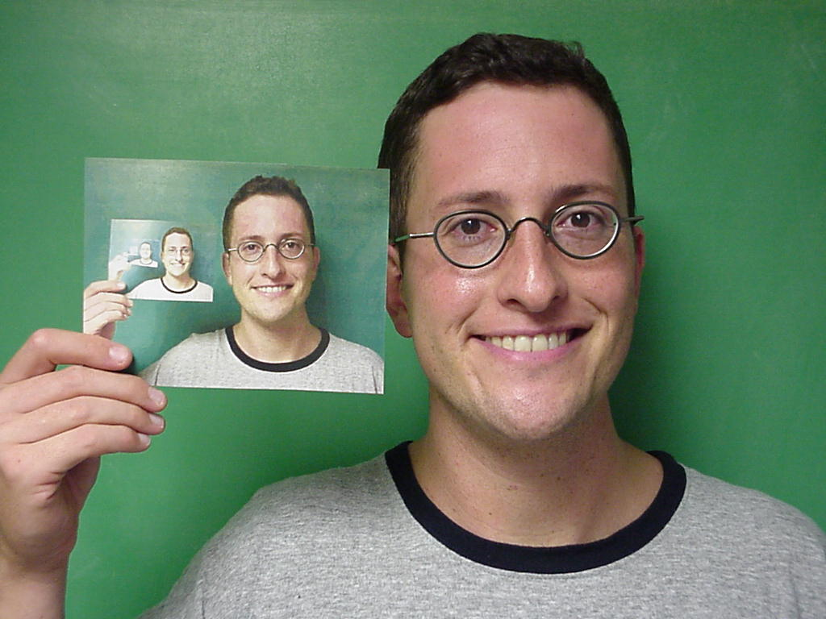
Recursion

Slide 5
Recursion: Technique
A recursive definition always has at least two parts, a boundary condition and a recursive case
The boundary condition defines a simple (basic) case that we know to be true.
The recursive case simplifies the problem by advancing just by a small step, and then calling itself.
At each level, the boundary condition is checked. If it is reached the recursion ends. If not, the recursion continues.

Slide 6
Example No. 1
Fibonacci Series: This series starts with ‘0’ & ‘1’ as, first & second elements respectively. And every next element is calculated as sum of previous two numbers.
0, 1, 1, 2, 3, 5, 8, 13, 21, 34, 55,……
Input: 1
Output: 0
Input: 2
Output: 1
Input: 4
Output: 2

Slide 7
Example No. 1: Implementation
int Fib (int value){ // a recursive function
if (value == 1) return 0;
if (value == 2) return 1;
if (value > 2)
return ( Fib (value-1) + Fib (value-2)) ;
}
Refer fib.java

Slide 8
Example No. 2: Character Permutations
Give all possible permutations of chars from given character string
Input: bc
Output: bc, cb
Input: abc
Output: abc, acb, bac, bca, cba, cab
Input: abcd
Output: abcd, abdc, acbd, acdb, adcb, adbc,
bacd, badc, bcad, bcda, bdca, bdac…

Slide 9
Example No. 2: Character Permutations
Input: abc
Interm. Step:
[1] abc :- as it is
[2] bac :- swap 1st with 2nd char
[3] cba :- swap 1st with 3rd char
Technique:
abc → [(a, bc), (a, cb)]
bac → [(b, ac), (b, ca)]
cba → [(c, ba), (c, ab)]

Slide 10
Character Permutations….
Input: “abcd” ……..(length is 4)
Here we should make recursive calls as shown below,
[1] (a, bcd)
a-bcd, a-bdc, a-cbd, a-cdb, a-dcb, a-dbc
[2] (b, acd)
[3] (c, bad)
[4] (d, bca)
Four calls because the string’s length is 4.

Slide 11
General Method
Input: “C1C2C3C4.......Cn-2Cn-1Cn”
Make recursive call to
(C1 , C2C3C5.......Cn-2Cn-1Cn) , it will invoke same function recursively as follows,
(C1C2, C3C4C5.......Cn-2Cn-1Cn)
(C1C2C3,C4C5.......Cn-2Cn-1Cn)
(C1C2C3C4,C5.......Cn-2Cn-1Cn)
:
:
(C1C2C3C4C5....... Cn-3,Cn-2Cn-1Cn) ←

Slide 12
Application
Parsing (Adjective and Nouns)
http://arti.vub.ac.be/~joachim/webpage/node30.html

Slide 13
Thanks!

